Slide 1

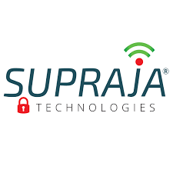
Webcam Spyware Security
Protecting your privacy in a connected world.
TEAM MEMBERS:
ST#IS#7758
ST#IS#7761
ST#IS#7762
ST#IS#7731
ST#IS#7760

Slide 2



Presentation Overview
01
02
Introduction to Webcam Security
Key Features of the Application
Understanding the threats and the need for protection.
Exploring the functionalities designed for your security.
03
04
Authentication & Logging
Intruder Detection & Response
How the system ensures secure access and tracks activity.
What happens when unauthorized access is attempted.
05
06
Configuration & Setup
Conclusion & Next Steps
Customizing the application for your needs.
Summarizing key takeaways and future developments.

Slide 3



Understanding Webcam Security Threats
In today's digital age, webcams can be vulnerable to unauthorized access, leading to privacy breaches and potential misuse. Spyware can secretly activate your camera, recording your activities without your knowledge.
Unauthorized Access
Privacy Breaches
Data Misuse
Malicious software can gain control of your webcam.
Sensitive personal moments can be captured and exposed.
Recorded footage can be used for blackmail or identity theft.

Slide 4





Key Features of the Application
Our Webcam Spyware Security application provides robust features to protect your privacy.
Camera Control
Secure Authentication
Easily enable or disable your webcam with a single click.
Password protection for critical actions.
Activity Logging
Intruder Video Capture
Detailed records of all webcam actions and access attempts.
Automatic recording of unauthorized access attempts.

Slide 5
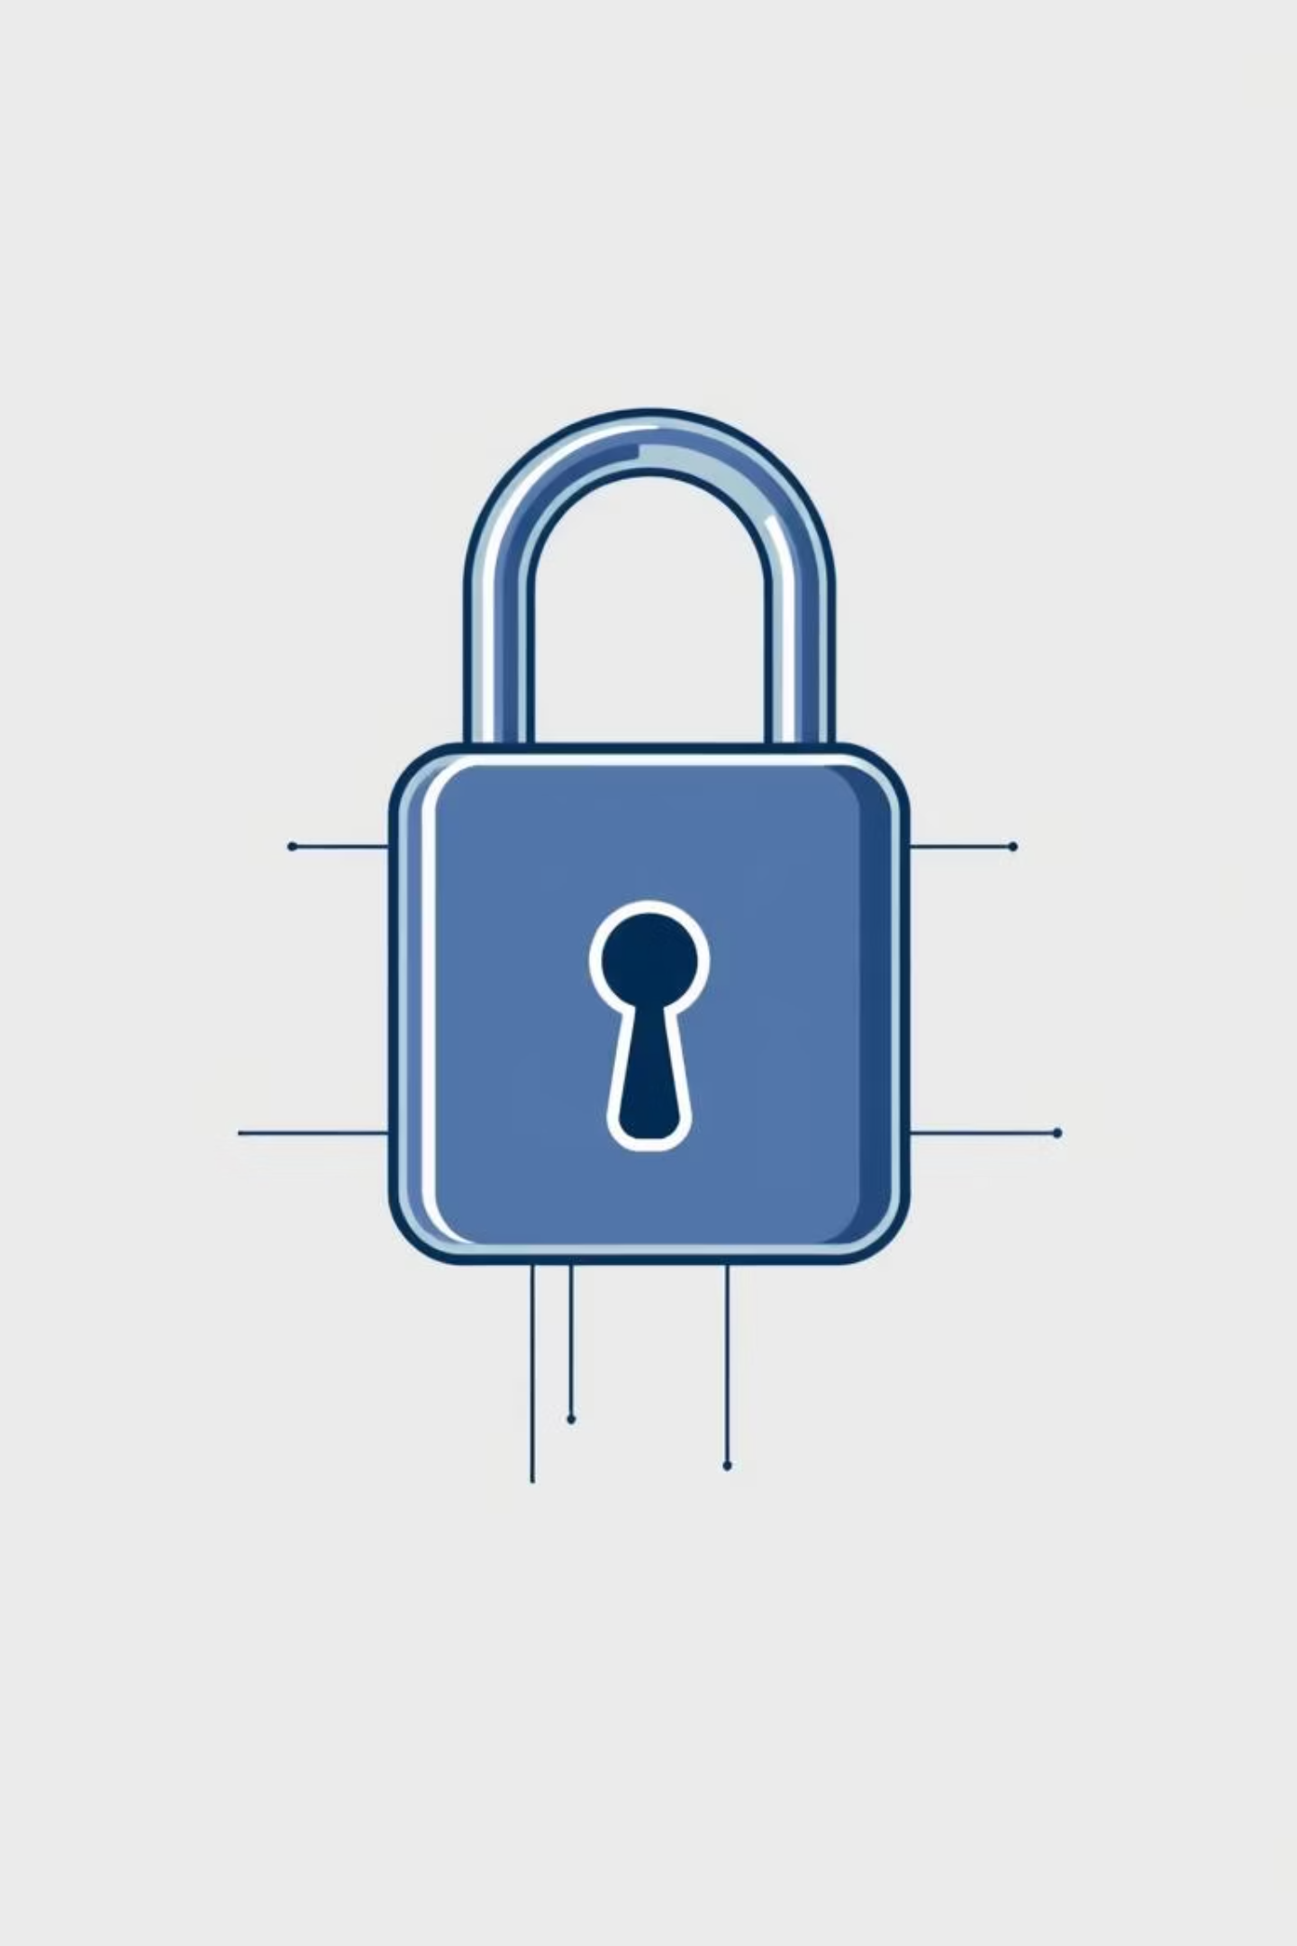

Secure Authentication
The application ensures that only authorized users can control webcam functions or access sensitive information.
Password Protection
Change Credentials
All critical actions, such as enabling or disabling the camera, require password authentication.
Users can easily change their username and password for enhanced security.

Slide 6


Activity Logging & Monitoring
Every action within the application is meticulously logged, providing a transparent record of webcam activity.
HTML Log File
1
All actions are saved to an HTML file (logs.html) for easy viewing.
2
Timestamped Entries
Each log entry includes a timestamp for precise tracking.
GUI Activity Log
3
Real-time updates are displayed in the application's activity log.
4
Status Indicators
Visual cues (emojis, colors) indicate whether the camera was enabled or disabled.

Slide 7
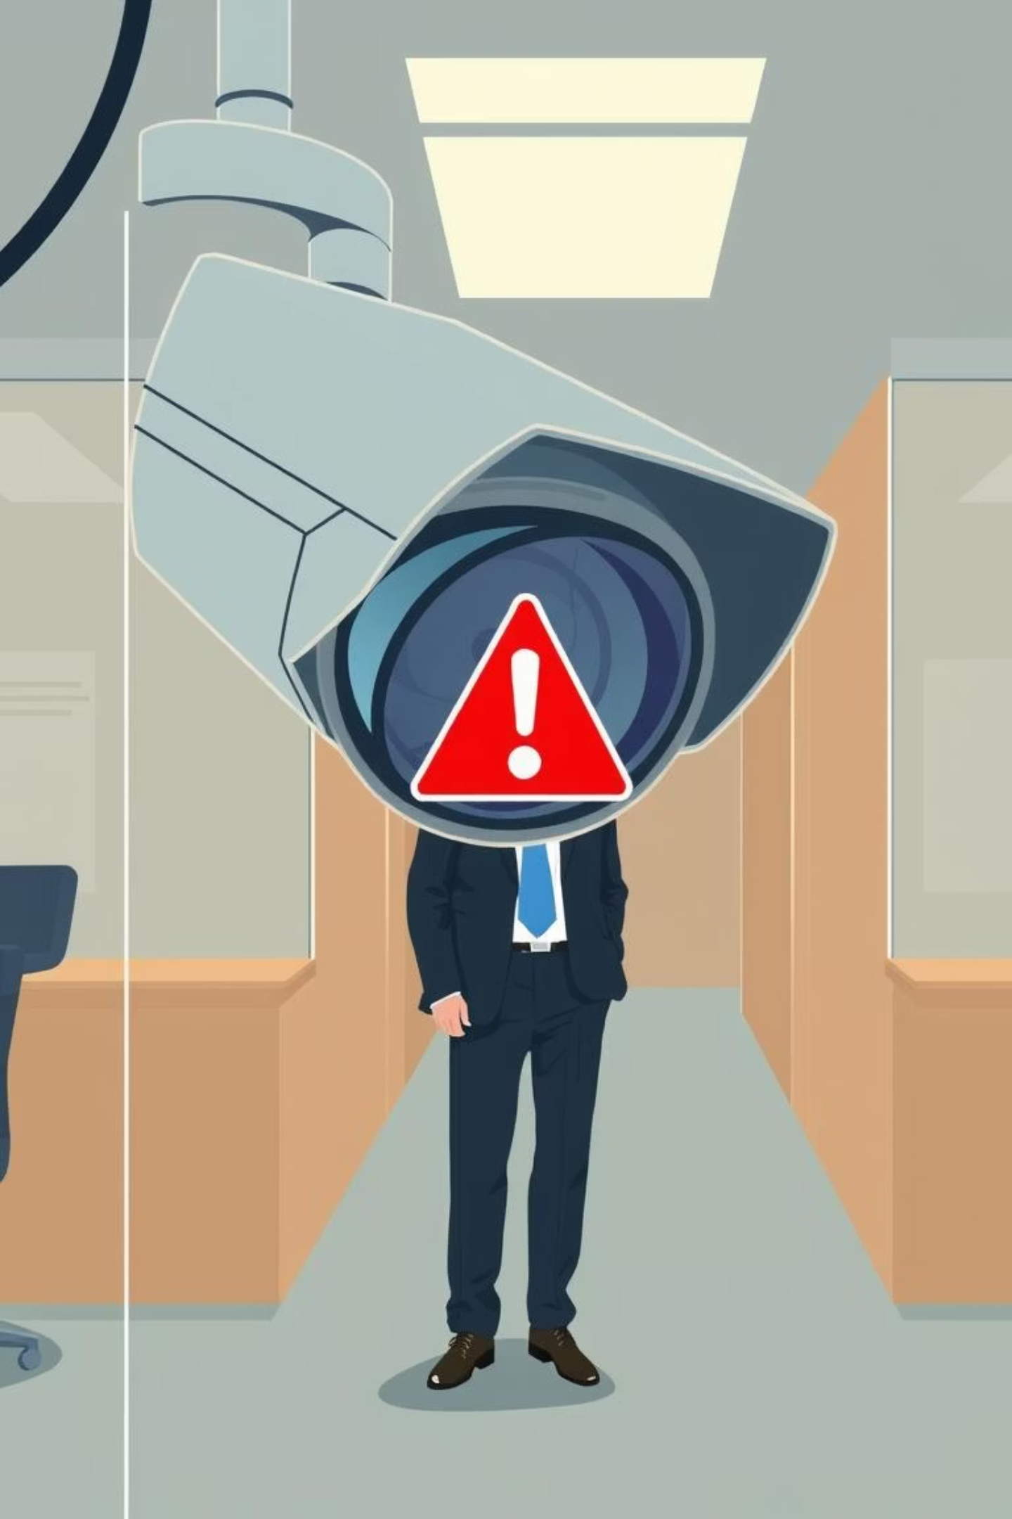
Intruder Detection & Response
In the event of an unauthorized access attempt, the application automatically records a video of the intruder.
Automatic Recording
Log Notification
If an incorrect password is entered, a 10-second video is recorded using the webcam.
A "⚠️ Intruder video recorded" message is added to the activity log.

Slide 8


Configuration & Commands
The application uses PowerShell commands to interact with your system's camera devices.
Configuration
HTML Log File: logs.html
Default Username: admin
Default Password: admin
PowerShell Commands
Disable Camera: Disable-PnpDevice
Enable Camera: Enable-PnpDevice
Check Status: Get-PnpDevice

Slide 9


User Interface Overview
The application features a user-friendly graphical interface for easy interaction.
Main Window
Activity Log
Displays the application title, an image, and various control buttons.
A dedicated text box displays real-time activity updates and messages.
Project Info
Timestamped entries
View Logs
Scrollable view
Check Status
Read-only access
Change Password
Disable Camera
Enable Camera
Exit

Slide 10





Summary & Next Steps
The Webcam Spyware Security application provides essential tools for protecting your privacy.
Enhanced Privacy
Continuous Monitoring
Intruder Deterrence
Gain control over your webcam and prevent unauthorized access.
Keep track of all webcam activities with detailed logs.
Automatically capture evidence of suspicious activity.
Future Enhancements
We plan to explore features like scheduled camera control and advanced notification options.

